Slide 1
Agents &
Artificial Intelligence
Rachel Cavill

Slide 2
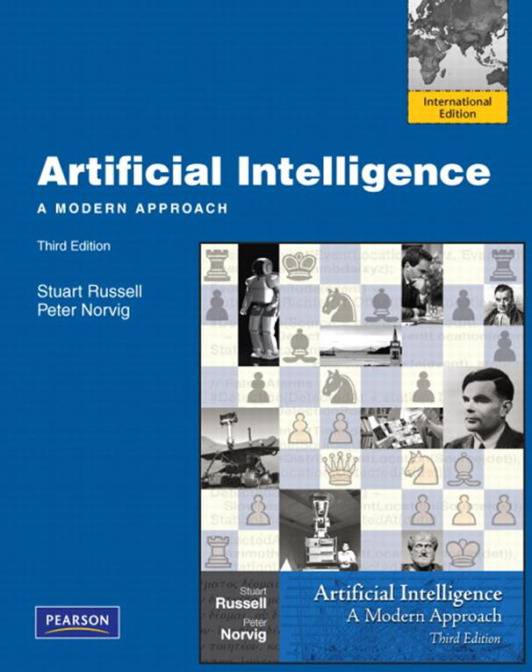
Course Material
Course material:
See student portal
Textbook:
Russell and Norvig: Artificial Intelligence: A Modern Approach, Prentice Hall, 2010, third Edition + additional readings

Slide 3
Grading
Written examination:50%
Practicals : 4 assignments 40% (10% each)
Debates week 6 : pass/fail for participation worth 10%

Slide 4
How much study?
This course is worth 4 ECTS
1 ECTS = 28 hrs study
4 * 28 = 112 hrs
In class we have 6 hours per week for 5 weeks + 4 hours in week 6, so 34 hours total.
112 – 34 = 78 hours left for study outside class.
4 assignments, 10 hours per assignment = 40 hours.
Debate preparation = 5 hours
That leaves 33 hours for revision.

Slide 5
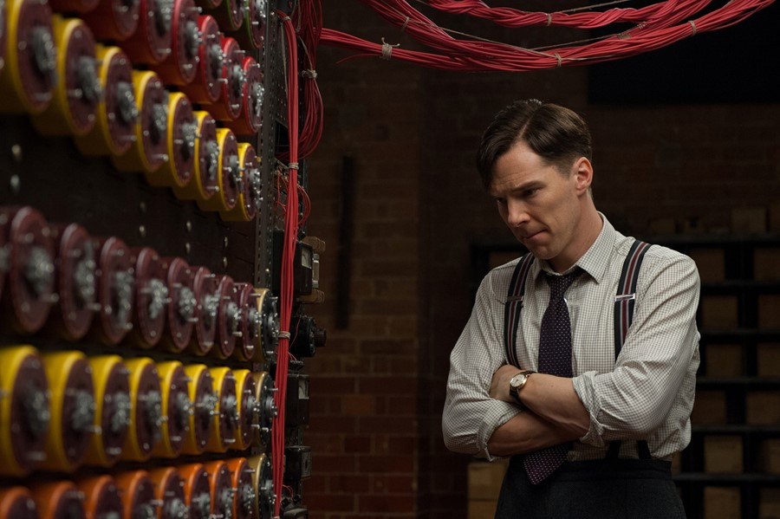

Who is this?

Slide 6
Alan Turing (1912-1954)
Codebreaking (Enigma)
Turing Machine
Computer Chess
Turing Test
Turing Award

Slide 7
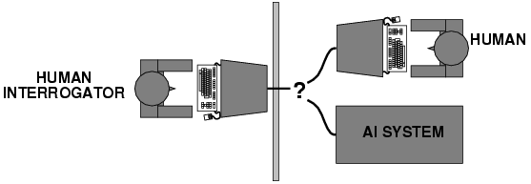

Turing Test
Can you tell whether you are talking to an AI or a human?

Slide 8
Examples
Think of an AI you know from film, books or real life.
Would it pass the Turing test? Why?

Slide 9

Problems with the Turing test
Can a program pass without being ‘intelligent’?

Slide 10
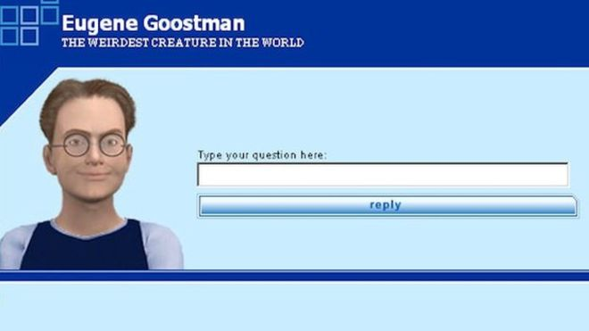
Gaming the Turing Test
Joking, misdirection, deflection
More about human psychology
Scott: Which is bigger, a shoebox or Mount Everest? Eugene: I can’t make a choice right now. I should think it out later. And I forgot to ask you where you are from… Scott: How many legs does a camel have? Eugene: Something between 2 and 4. Maybe, three? :-))) By the way, I still don’t know your specialty – or, possibly, I’ve missed it?
Notes:
Goostman is portrayed as a 13-year-old Ukrainian boy—characteristics that are intended to induce forgiveness in those with whom it interacts for its grammatical errors and lack of general knowledge
“Passed” the test 33% in 2014 of the judges were convinced that the bot was human

Slide 11
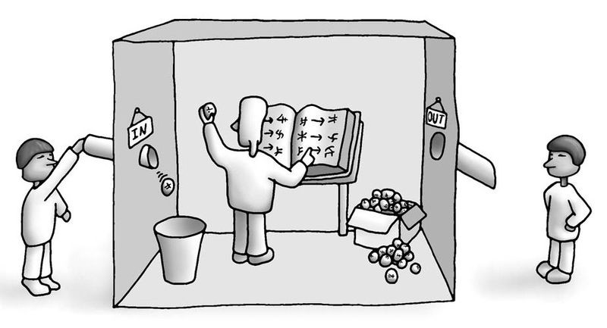
Chinese room

Slide 12
Welsh room

Slide 13
Welsh room – what was said
Bore da
Helo
Shwd wyt ti?
Da iawn, diolch. Oer Heddiw
Nag ydy! Dych chi’n hoffi’r lle ‘ma?
Ydw! Dw I’n hoffi’r lle ‘ma.
Ble oeddet ti am unarddeg o’r gloch neithiwr?
Ro’n I ynn y tŷ bach.
Gyda Pwy oeddet ti?
Ro’n I mewn tŷ bwyta ‘da menyw.
Good morning
Hello
How are you?
Very well thank you, Cold today eh?
It’s not! Do you like this place?
Yes I like this place
Where were you at eleven o’clock last night?
I was in the toilet.
Who were you with?
I was in a restaurant with a lady.

Slide 14
Problems with the Turing test
Humans can sometimes (often?) be classified as a machine by the Turing test judges.
In 2011, a test of the Cleverbot AI took place. Judges were asked to rate each conversation on it’s humanity from 1-10. The AI scored 5.9, but the humans only scored 6.3!

Slide 15
Summarise - Problems with the Turing test
Can improve chance of passing through psychological strategies
Doesn’t test ‘intelligence’, just responses – chinese room problem
Humans can ‘fail’ to convince the judges they are not computers.

Slide 16

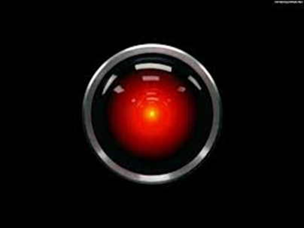
Advantages of Turing Test
Objective notion of Intelligence
Avoids discussion of internal processes and consciousness
Eliminates bias in favor of living organism

Slide 17
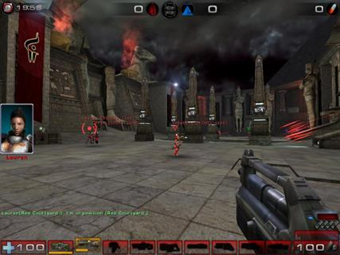

Human-like behaviour can be useful
Entertainment Industry
Believable Non-Playable Characters (NPC)
Human-Like Bot Competitions
Chatbots giving advice on websites

Slide 18
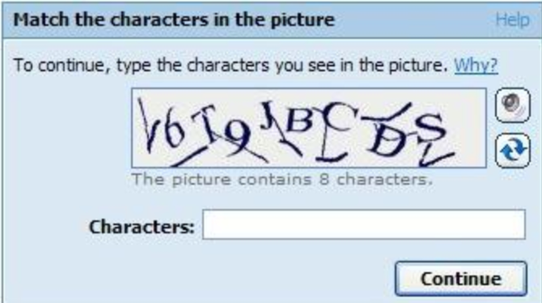
CAPTCHA and the Turing Test
CAPTCHA is a reverse Turing test, it’s trying to pick out the humans from the machines.

Slide 19

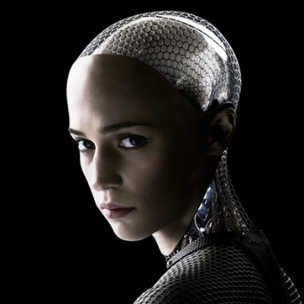
Total Turing Test
Original Turing Test: No Physical Interaction
Total Turing Test:
Includes a video signal so the interrogator can test the subject perceptual abilities
Pass Physical Object “through the hatch”
Suggested additional components of AI:
Computer vision: to perceive objects
Robotics: To manipulate and move them
Completely pass as human
Ex Machina

Slide 20

More to AI than the Turing Test
Views of AI fall into four categories:
Which does the Turing test test?
Which is more important?
Thinking humanly | Thinking rationally
Acting humanly | Acting rationally

Slide 21
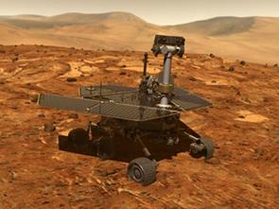
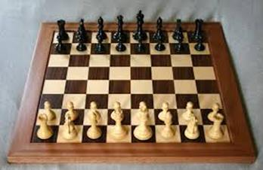
Rational programs
For any given class of environments and tasks, we seek the program (or class of programs) with the best performance
Caveat: computational limitations make perfect rationality unachievable → design the best program for given machine resources
Notes:
Mars rover

Slide 22
A brief potted history of AI
Won’t be on the exam!

Slide 23
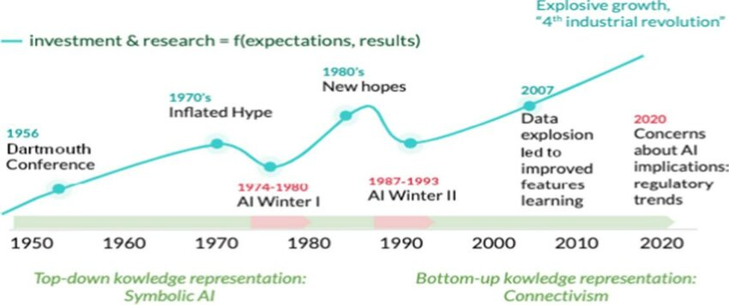
AI comes in waves
Image:
https://www.researchgate.net/publication/372590389_A_Critical_Historic_Overview_of_Artificial_Intelligence_Issues_Challenges_Opportunities_and_Threats

Slide 24
General AI is always just a few years away
John McCarthy(1958-):
Inventor of Lisp (second‐oldest high‐level language)
Moravec (1988) claims that John McCarthy founded the Stanford AI project in 1963 “with the then-plausible goal of building a fully intelligent machine in a decade” (p. 20).
Notes:
Fortran is the oldest

Slide 25
Modern examples of AI

Slide 26

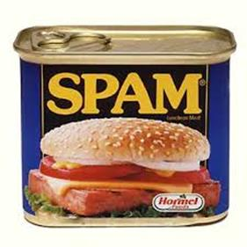
Spam Fighting
Learning algorithms classify over a billion messages as spam

Slide 27
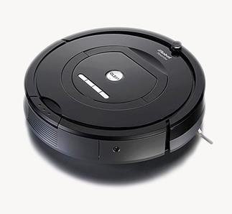
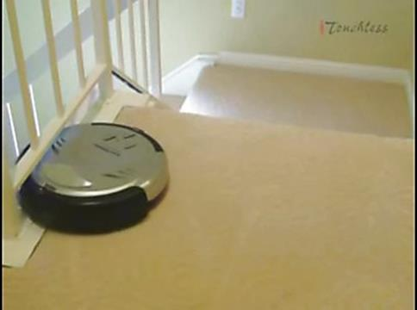
Vacuum cleaning
iRobot cooperation has sold 10 million Roomba robotic vacuum cleaners for home use since 2002

Slide 28

ChatGPT
2022-23 Large Language Models such as GPT enable the development of chatGPT, a powerful conversational AI.
Similar tools can also assist with writing code (copilots)

Slide 29

AI generated Art
2022-23: Tools like midjourney, can generate art from text descriptions.

Slide 30
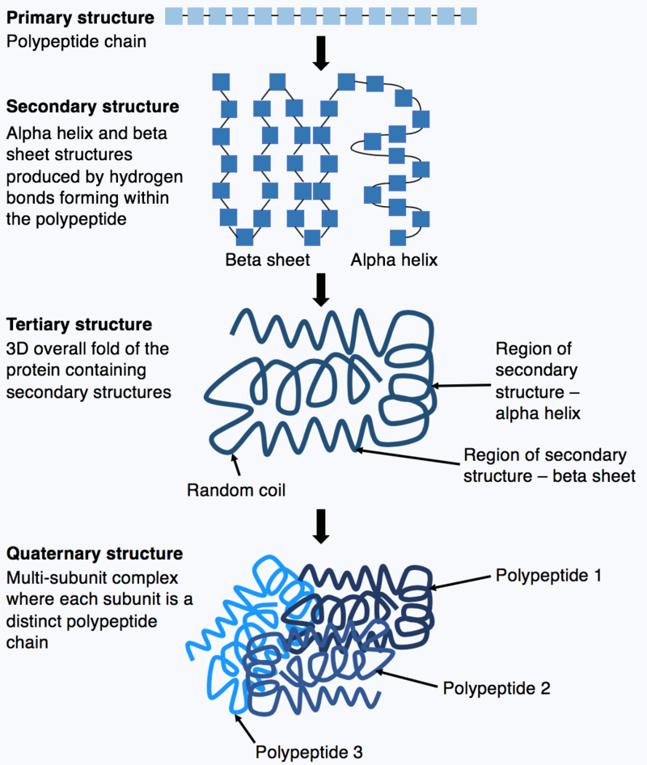
Protein folding
2018: Alphafold became the first deep learning model to dramatically increase the performance of pretein folding models

Slide 31
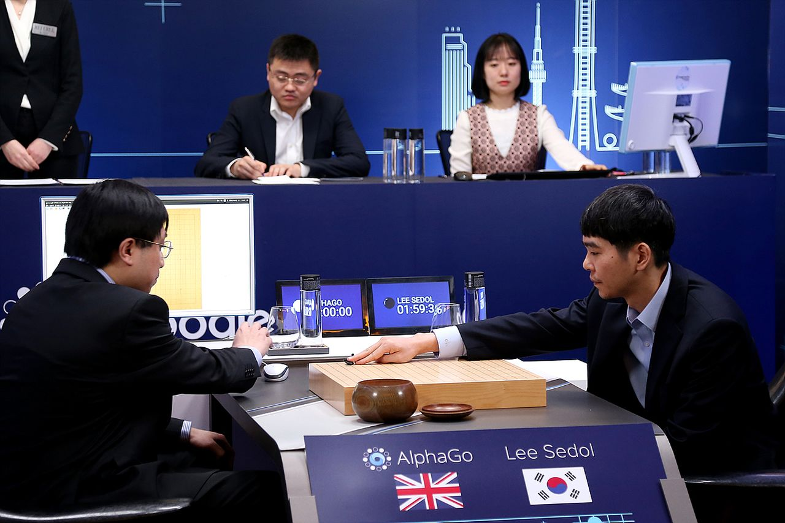
Go
2016: AlphaGo defeats strongest human player, Lee Sedol
Developped by Google Deepmind

Slide 32
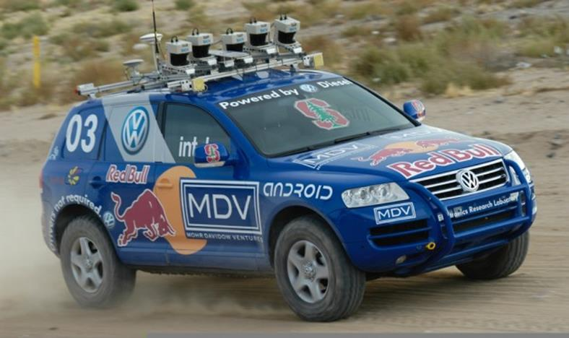
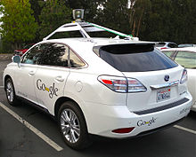
Autonomous Driving
Driverless robotic car Stanley sped at 22 mph through the Mojave dessert over a 132 mile course (2005)
Google Self-Driving Car (2010)

Slide 33
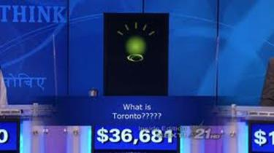
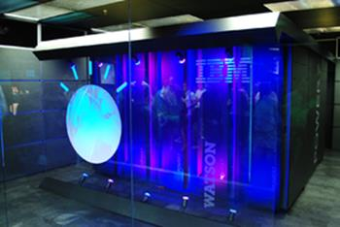
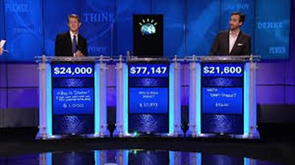
Quiz Show contestant
Watson (IBM)
First in Jeopardy (2011)
www.ibm.com/smarterplanet/us/en/ibmwatson/

Slide 34
Limits
Each program is good in its own domain, but it can’t do all tasks
Machine Translation of obscure languages
Acting as a judge
Beating humans in soccer
General Game Playing
Writing pieces with correct facts and references
Explaining decisions
Notes:
The spirit is willing, but the flesh is weak

Slide 35

More limitations?
What examples can you think of?
Notes:
The spirit is willing, but the flesh is weak

Slide 37

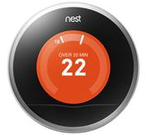
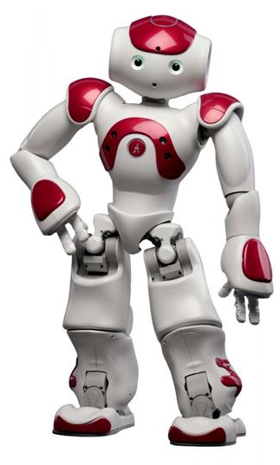

Agents
An agent is anything that can be viewed as perceiving its environment through sensors and acting upon that environment through actuators
An agent operates autonomously
Examples?
Agents include humans, robots, softbots, thermostats, etc.
Notes:
Including the annoying Office Assistant 2003

Slide 38
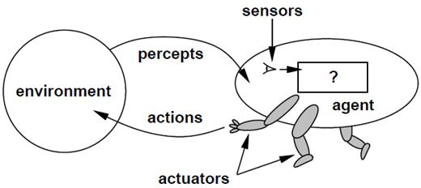
Agents
An agent is an entity that perceives and acts We focus on designing rational agents Abstractly, an agent is a function from perception history to an action:
[f: P* → A]

Slide 39
Example of agents
Human agent:
Sensors?
eyes, ears, and other organs
Actuators?
hands, legs, mouth, and other body parts for actuators
Robotic agent:
Sensors?
cameras and infrared range finders;
Actuators
various motors

Slide 40
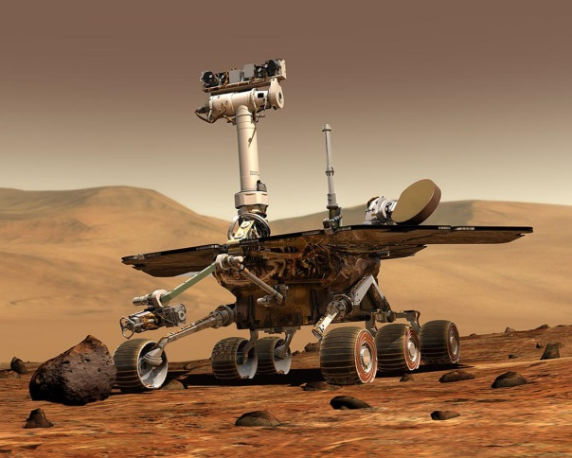

Example: Mars Exploration Rover
Direct remote control is not possible
It takes 10 minutes to send a message from Earth to Mars
Not possible to predict with sufficient accuracy what the robot will encounter in its environment
The robot needs to operate autonomously!

Slide 41
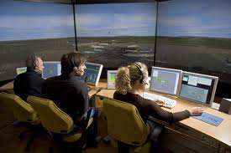

Example: Air Traffic Control
Air traffic Control: e.g., OASIS
Optimal Aircraft Sequencing using Intelligent Scheduling
Aids traffic control for incoming flights
Each plane represented by an agent
Negotiation among the agents determines the order of landing
Notes:
developed for Sydney's Kingsford Smith airport

Slide 42
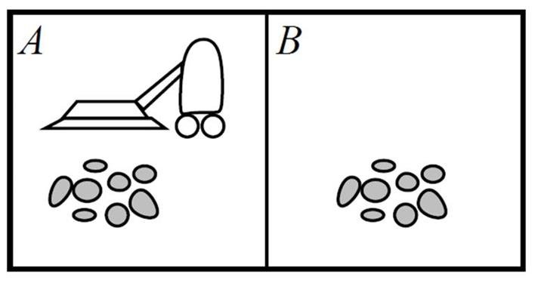
Vacuum-cleaner world
Percepts: location and contents, e.g., [A,Dirty]
Actions: Left, Right, Suck, NoOp

Slide 43
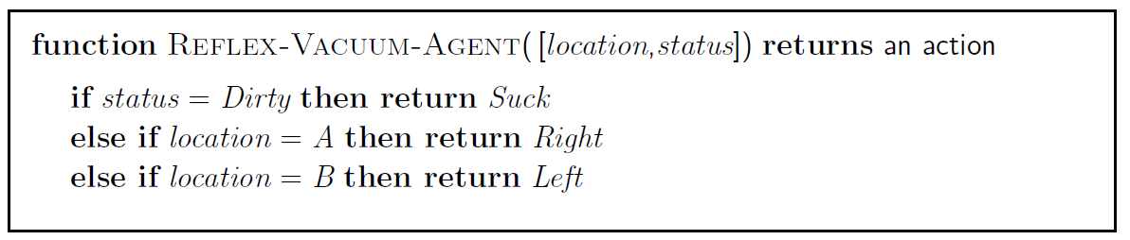
A vacuum-cleaner agent
Percept Sequence | Action
[A, Clean] | Right
[A, Dirty] | Suck
[B, Clean] | Left
[B, Dirty] | Suck
[A, Clean], [A, Clean] | Right
[A, Clean], [A, Dirty] | Suck

Slide 44
Rational agents
An agent should strive to "do the right thing", based on what it can perceive and the actions it can perform
The right action is the one that will cause the agent to be most successful
Performance measure: An objective criterion for success of an agent's behavior
Performance measure of a vacuum-cleaner agent:
amount of dirt cleaned up
cleanness of the environment
amount of time taken
amount of electricity consumed
amount of noise generated, etc.

Slide 45
Rational agents
Rational Agent: For each possible percept sequence, a rational agent should select an action that is expected to maximise its performance measure, given the evidence provided by the percept sequence and whatever built-in knowledge the agent has

Slide 46
Rational agents
Rationality is distinct from omniscience (all-knowing with infinite knowledge)
Agents can perform actions in order to modify future percepts so as to obtain useful information
information gathering, exploration
An agent is autonomous if its behavior is determined by its own experience (with ability to learn and adapt)
A rational agent needs to be autonomous to adapt to new situations

Slide 47
PEAS
To design an agent we need to know:
P performance measure
E environment
A actuators
S sensors
We can already describe P, A and S formally, but we need a formal way to classify environments

Slide 48
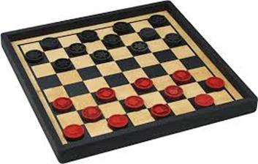
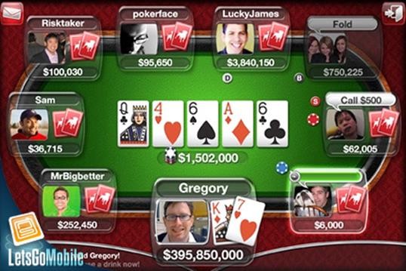
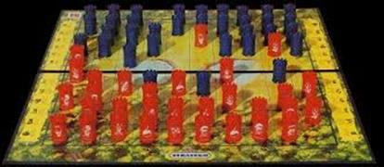
Environment types
Fully observable (vs. partially observable): An agent's sensors give it access to the complete state of the environment at each point in time
Fully observable Partially observable

Slide 49
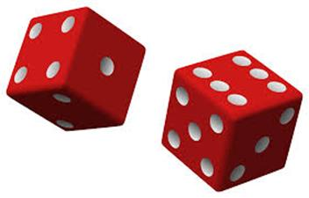
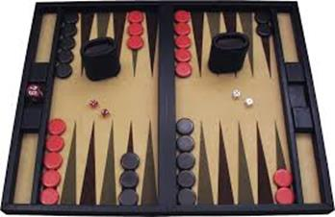
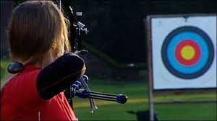
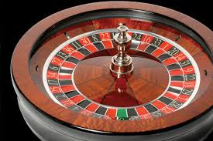
Environment types
Deterministic (vs. stochastic): The next state of the environment is completely determined by the current state and the action executed by the agent.
Deterministic Stochastic

Slide 50
Environment Types
Episodic (vs. sequential): The agent's experience is divided into atomic "episodes" (each episode consists of the agent perceiving and then performing a single action), and the choice of action in each episode depends only on the episode itself
Static (vs. dynamic): The environment is unchanged while an agent is deliberating.
The environment is semidynamic if the environment itself does not change with the passage of time but the agent's performance score does

Slide 51
Environment types
Discrete (vs. continuous): A limited number of distinct, clearly defined percepts and actions
Single agent (vs. multiagent): An agent operating by itself in an environment

Slide 52
Environment types
Task
Environment
Observable
Agents
Deterministic
Episodic
Static
Discrete
Cross
word Puzzle
Fully
Single
Deterministic
Sequential
Static
Discrete
Chess with a clock
Fully
Multi
Deterministic
Sequential
Semi
Discrete
Poker
Partially
Multi
Stochastic
Sequential
Static
Discrete
Backgammon
Fully
Multi
Stochastic
Sequential
Static
Discrete
Taxi Driving
Partially
Multi
Stochastic
Sequential
Dynamic
Continuous
Medical
Diagnosis
Partially
Single/
Multi
Stochastic
Sequential
Dynamic
Continuous
Image Analysis
Fully
Single
Deterministic
Episodic
Semi
Continuous
Part
Episodic
Continuous
-
Picking
Robot
Partially
Single
Stochastic
Dynamic
Refinery Controller
Partially
Single
Stochastic
Sequential
Dynamic
Continuous
Interactive English
Partially
Multi
Stochastic
Sequential
Dynamic
Discrete
Tutor
Notes:
Medical diagonosis system can be argued as multi-agent, when patients, staff is involved
Playing a chess tournament can be regarded episodic, on a high level, a the performance in one game is not influenced played in the previous game

Slide 53

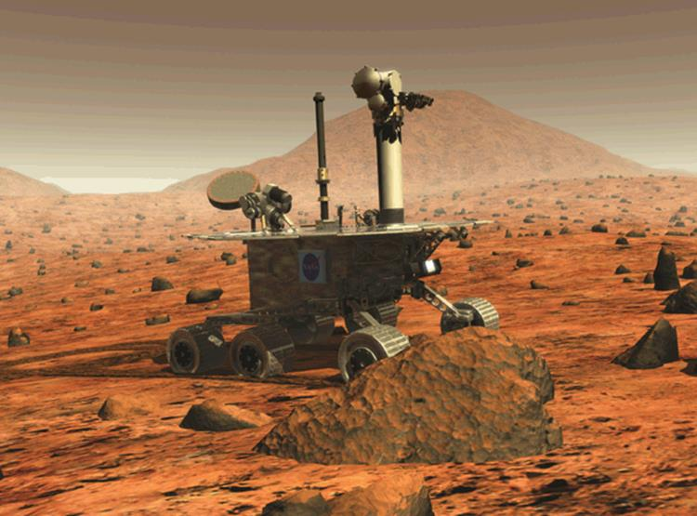
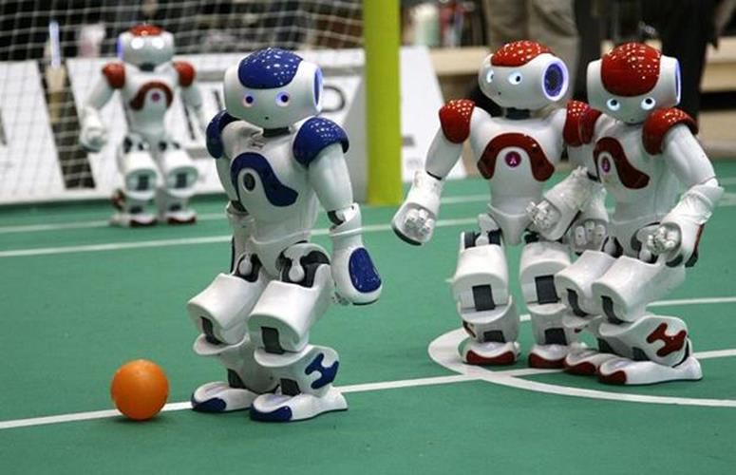
Exercise: Environment types
Task Environment | Observable | Agents | Deterministic | Episodic | Static | Discrete
Mars Exploration Agent
Chess without a clock
Internet Shopping
Soccer

Slide 54
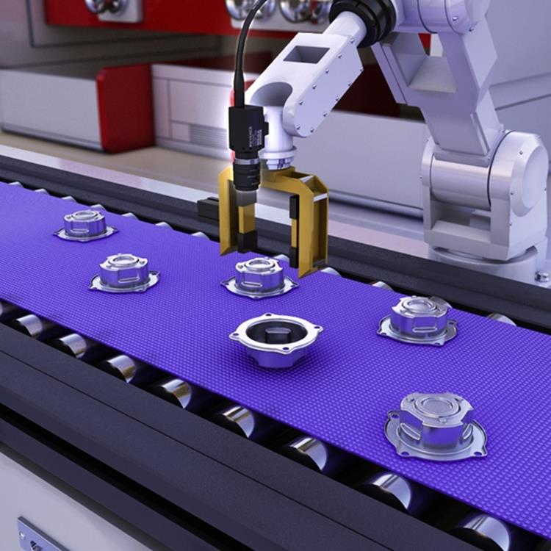
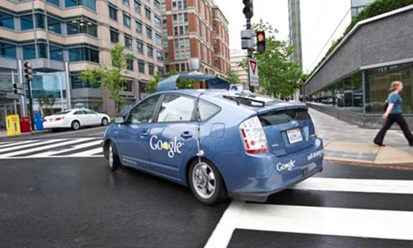
Environment types
The environment type largely determines the agent design
The real world is always partially observable, stochastic, sequential, dynamic, continuous, multi-agent

Slide 55

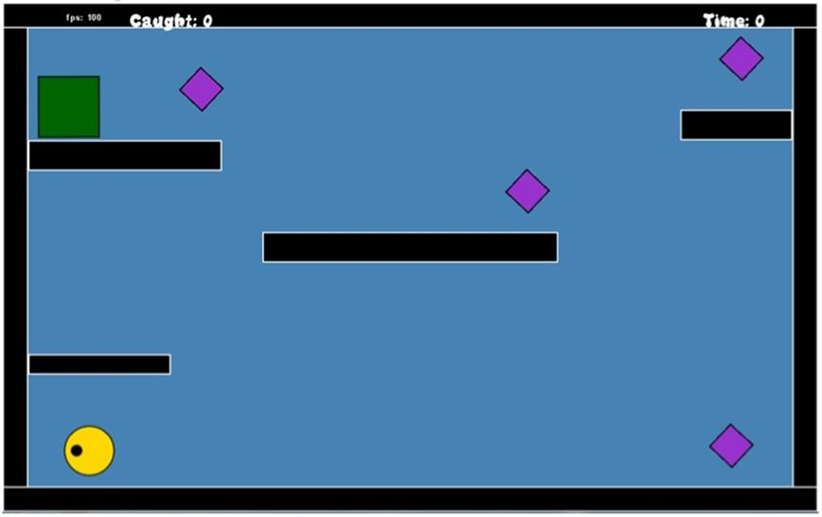
Environment types
Known (vs unknown) state of knowledge of the “law of physics” of the environment
Poker games are partially observable, but the environment is known (i.e., the rules)
A video game can be fully observable, but you may have no idea what the result of the action until you try

Slide 56
The structure of Agents

Slide 57
Agent functions and programs
An agent is completely specified by the agent function mapping percept sequences to actions
One agent function (for a small equivalence class) is rational
Aim: find a way to implement the rational agent function concisely

Slide 58
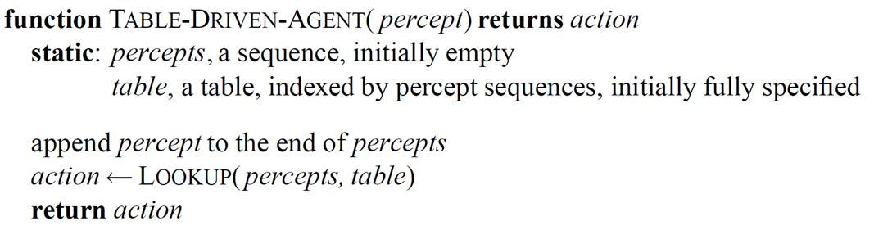
Table-lookup agent
Drawbacks:
Huge table
Take a long time to build the table
No autonomy
Even with learning, need a long time to learn the table entries
Percept Sequence | Action
[A, Clean] | Right
[A, Dirty] | Suck
[B, Clean] | Left
[B, Dirty] | Suck
[A, Clean], [A, Clean] | Right
[A, Clean], [A, Dirty] | Suck

Slide 59
Agent types
Four basic types in order of increasing generality:
Simple reflex agents
Model-based reflex agents
Goal-based agents
Utility-based agents
All can be turned into learning agents

Slide 60
Example: A vacuum-cleaner agent

Slide 61
Simple reflex agents
Select action on the basis of only the current percept
E.g. the vacuum‐agent
Large reduction in possible percept/action situations
Implemented through condition‐action (if-then) rules
If dirty then suck
Will only work if the environment is fully observable otherwise infinite loops may occur
Randomization may help

Slide 62
Model-based reflex agents
To tackle partially observable environments
Maintain internal state
Over time update state using world knowledge
How does the world change
How do actions affect world
⇒ Model of the World

Slide 63
Goal-based agents
The agent needs a goal to know which situations are desirable
More tricky when long sequences of actions are required to find the goal
Typically investigated in search and planning research
Major difference: future is taken into account
Is more flexible since goals are represented explicitly and can be changed

Slide 64
Utility-based agents
Certain goals can be reached in different ways
Some are better, have a higher utility
Utility function maps a (sequence of) state(s) onto a real number
Improves on goals:
Selecting between conflicting goals
Select appropriately between several goals based on likelihood of success

Slide 65

Exam checklist
Turing test
What?
Why?
Pros/Cons
Thinking/Acting Humanly/Rationally
Differences between these approaches
Examples of what current AI can/can’t do?
Notes:
The spirit is willing, but the flesh is weak

Slide 66

Exam check list
What is an agent?
When is it rational? autonomous?
PEAS
Describing environments
observable? deterministic? episodic? static? discrete? single-agent?
Basic agent architectures
reflex, model-based reflex, goal-based, utility-based

Slide 67

For further study…
Chapters 1 and 2 of Russell and Norvig: Artificial Intelligence: A Modern Approach, Prentice Hall, 2010, third Edition

